Slide 1


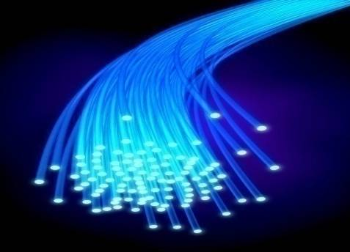



Slide 2
Syllabus
Signal Characteristic
Data Communication
Signal Encoding Techniques
Bandwidth Utilization: Multiplexing and Spreading
Transmission Media
Switching System and Communication Networks
Wireless WAN
Communication Technologies
Data Link Control

Slide 3
Topics:
Analog and Digital
Periodic Analog Signals
Digital Signals
Transmission Impairments
Data rate limits
Performance

Slide 4
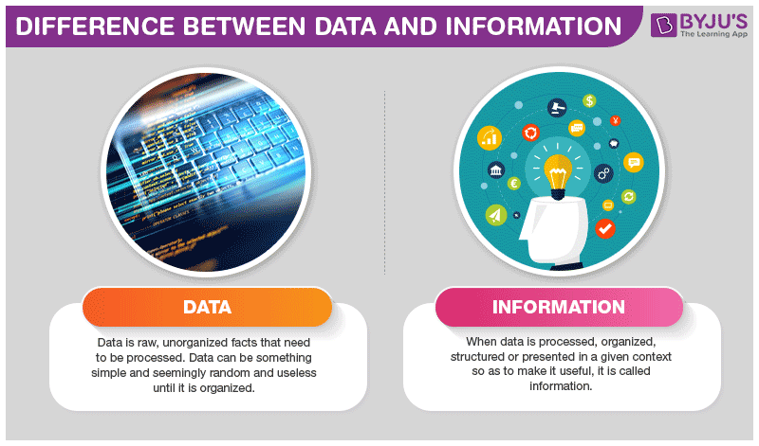
Data Vs. Information Vs. Signal
[3] Image: https://byjus.com/biology/difference-between-data-and-information/

Slide 5

Data: Analog & Digital
Data can be analog or digital. Analog data refers to information that is continuous; Digital data refers to information that has discrete states. Analog data take on continuous values. Digital data take on discrete values.
Comparison of analog and digital signals
[1] Data Communications and Networking: Behrouz Forouzan, 4th Edition.

Slide 6



Periodic & Aperiodic Signals: Frequency & Time Period
Periodic analog signals can be classified as simple or composite.
A simple periodic analog signal, a sine wave, cannot be decomposed into simpler signals.
A composite periodic analog signal is composed of multiple sine waves.
[1] Data Communications and Networking: Behrouz Forouzan, 4th Edition.

Slide 7

Peak Amplitude
[1] Data Communications and Networking: Behrouz Forouzan, 4th Edition.

Slide 8

Period & Frequency
Ex: The power we use at home has a frequency of 50 Hz. The period of this sine wave is ?
[1] Data Communications and Networking: Behrouz Forouzan, 4th Edition.

Slide 9

Example
The period of a signal is 100 ms. What is its frequency in kilohertz?
Solution
First we change 100 ms to seconds, and then we calculate the frequency from the period (1 Hz = 10⁻³ kHz).

Slide 10

Note
If a signal does not change at all, its frequency is zero.
If a signal changes instantaneously, its frequency is infinite.

Slide 11

Phase
Phase describes the position of the waveform relative to time 0.
[1] Data Communications and Networking: Behrouz Forouzan, 4th Edition.

Slide 12

Example
A sine wave is offset 1/6 cycle with respect to time 0. What is its phase in degrees and radians?
Solution
We know that 1 complete cycle is 360°. Therefore, 1/6 cycle is

Slide 13
Note
Phase describes the position of the waveform relative to time 0.

Slide 14

Periodic & Aperiodic Signals: Wavelength
Wavelength is another characteristics of a signal travelling through a transmission medium.
Wavelength binds the period or frequency to the propagation speed.
Wavelength depends on the medium (e.g. vacuum, air, or water) that a wave travels through.
[1] Data Communications and Networking: Behrouz Forouzan, 4th Edition.

Slide 15

Time & Frequency Domains
A complete sine wave in the time domain can be represented by one single spike in the frequency domain.
[1] Data Communications and Networking: Behrouz Forouzan, 4th Edition.

Slide 16
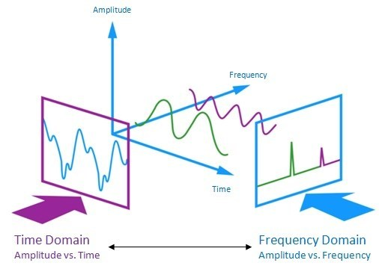
Time & Frequency Domains
A complete sine wave in the time domain can be represented by one single spike in the frequency domain.
[4] http://play.fallows.ca/wp/radio/ham-radio/signal-analysis-morse-decoder/

Slide 17

Time & Frequency Domains
A single-frequency sine wave is not useful in data communications;
we need to send a composite signal, a signal made of many simple sine waves.
[1] Data Communications and Networking: Behrouz Forouzan, 4th Edition.

Slide 18

Composite Signal
According to Fourier analysis, any composite signal is a combination of simple sine waves with different frequencies, amplitudes, and phases.
If the composite signal is periodic, the decomposition gives a series of signals with discrete frequencies; if the composite signal is nonperiodic, the decomposition gives a combination of sine waves with continuous frequencies.
[1] Data Communications and Networking: Behrouz Forouzan, 4th Edition.

Slide 19

Composite Signal
According to Fourier analysis, any composite signal is a combination of simple sine waves with different frequencies, amplitudes, and phases.
If the composite signal is periodic, the decomposition gives a series of signals with discrete frequencies; if the composite signal is nonperiodic, the decomposition gives a combination of sine waves with continuous frequencies.
[1] Data Communications and Networking: Behrouz Forouzan, 4th Edition.

Slide 20

Bandwidth
The bandwidth of a composite signal is the difference between the highest and the lowest frequencies contained in that signal.
The time and frequency domains of a nonperiodic signal
[1] Data Communications and Networking: Behrouz Forouzan, 4th Edition.

Slide 21

Bandwidth
The bandwidth of periodic and nonperiodic composite signals
[1] Data Communications and Networking: Behrouz Forouzan, 4th Edition.

Slide 22

Example
If a periodic signal is decomposed into five sine waves with frequencies of 100, 300, 500, 700, and 900 Hz, what is its bandwidth? Draw the spectrum, assuming all components have a maximum amplitude of 10 V.
Solution
Let f_{h} be the highest frequency, f_{l} the lowest frequency, and B the bandwidth. Then
The spectrum has only five spikes, at 100, 300, 500, 700, and 900 Hz .

Slide 23

Figure The bandwidth for Example

Slide 24
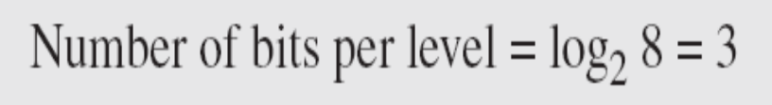

Digital Signals
Digital signal. For example, a 1 can be encoded as a positive voltage and a 0 as zero voltage. A digital signal can have more than two levels. In this case, we can send more than 1 bit for each level.
Figure 3 Two digital signals
[1] Data Communications and Networking: Behrouz Forouzan, 4th Edition.

Slide 25
Digital Signals
A digital signal has nine levels. How many bits are needed per level? We calculate the number of bits by using the formula. Each signal level is represented by 3.17 bits. However, this answer is not realistic. The number of bits sent per level needs to be an integer as well as a power of 2. For this example, 4 bits can represent one level.
Assume we need to download text documents at the rate of 100 pages per minute. What is the required bit rate of the channel?
Solution
A page is an average of 24 lines with 80 characters in each line. If we assume that one character requires 8 bits, the bit rate is
Information Rate=100x24x80x8/60 bps
[1] Data Communications and Networking: Behrouz Forouzan, 4th Edition.

Slide 26
Digital Signals
What is the bit rate for high-definition TV (HDTV)?
Solution
HDTV uses digital signals to broadcast high quality video signals. The HDTV screen is normally a ratio of 16 : 9. There are 1920 by 1080 pixels per screen, and the screen is renewed 30 times per second. Twenty-four bits represents one color pixel.
The TV stations reduce this rate to 20 to 40 Mbps through compression.
[1] Data Communications and Networking: Behrouz Forouzan, 4th Edition.

Slide 27

Digital Signals
Figure 4 Periodic & A periodic Digital Signal
[1] Data Communications and Networking: Behrouz Forouzan, 4th Edition.

Slide 28
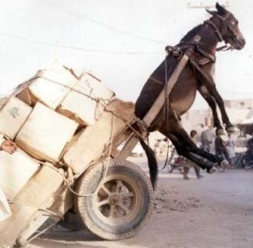
Why to Worry about signal and channel bandwidths ?

Slide 29

Baseband Transmission
A digital signal is a composite analog signal with an infinite bandwidth.
Baseband transmission means sending a digital signal over a channel without changing the digital signal to an analog signal.
Baseband transmission requires low pass channel.
Two types of channel: Wide bandwidth and Narrow bandwidth.
Figure 6 Baseband transmission
[1] Data Communications and Networking: Behrouz Forouzan, 4th Edition.

Slide 30

Bandwidth of low pass channels
[1] Data Communications and Networking: Behrouz Forouzan, 4th Edition.

Slide 31

Baseband Transmission
Baseband transmission of a digital signal that preserves the shape of the digital signal is possible only if we have a low-pass channel with an infinite or very wide bandwidth.
Figure 7 Baseband transmission using a dedicated medium
[1] Data Communications and Networking: Behrouz Forouzan, 4th Edition.

Slide 32

Digital Signals
Figure 8 Rough approximation of a digital signal using the first harmonic
[1] Data Communications and Networking: Behrouz Forouzan, 4th Edition.

Slide 33

Digital Signals
Figure 9 Simulating a digital signal with first three harmonics
[1] Data Communications and Networking: Behrouz Forouzan, 4th Edition.

Slide 34

Digital Signals
In baseband transmission, the required bandwidth is proportional to the bit rate; if we need to send bits faster, we need more bandwidth.
Figure 10 Bandwidth requirements
[1] Data Communications and Networking: Behrouz Forouzan, 4th Edition.

Slide 35

Digital Signals
What is the required bandwidth of a low-pass channel if we need to send 1 Mbps by using baseband transmission?
Solution
The answer depends on the accuracy desired.
a. The minimum bandwidth, is B = bit rate /2, or 500 kHz.
b. A better solution is to use the first and the third
harmonics with B = 3 × 500 kHz = 1.5 MHz.
c. Still a better solution is to use the first, third, and fifth
harmonics with B = 5 × 500 kHz = 2.5 MHz.
[1] Data Communications and Networking: Behrouz Forouzan, 4th Edition.

Slide 36

Digital Signals
We have a low-pass channel with bandwidth 100 kHz. What is the maximum bit rate of this channel?
Solution
The maximum bit rate can be achieved if we use the first harmonic. The bit rate is 2 times the available bandwidth, or 200 kbps.
If the available channel is a bandpass channel, we cannot send the digital signal directly to the channel;
we need to convert the digital signal to an analog signal before transmission.
This is known as broadband channel.
[1] Data Communications and Networking: Behrouz Forouzan, 4th Edition.

Slide 37

Digital Signals
Figure 11 Modulation of a digital signal for transmission on a bandpass Channel
[1] Data Communications and Networking: Behrouz Forouzan, 4th Edition.

Slide 38
Example
An example of broadband transmission using modulation is the sending of computer data through a telephone subscriber line, the line connecting a resident to the central telephone office. These lines are designed to carry voice with a limited bandwidth. The channel is considered a bandpass channel. We convert the digital signal from the computer to an analog signal, and send the analog signal. We can install two converters to change the digital signal to analog and vice versa at the receiving end. The converter, in this case, is called a modem
[1] Data Communications and Networking: Behrouz Forouzan, 4th Edition.

Slide 39
Example
A second example is the digital cellular telephone. For better reception, digital cellular phones convert the analog voice signal to a digital signal. Although the bandwidth allocated to a company providing digital cellular phone service is very wide, we still cannot send the digital signal without conversion. The reason is that we only have a bandpass channel available between caller and callee. We need to convert the digitized voice to a composite analog signal before sending.
[1] Data Communications and Networking: Behrouz Forouzan, 4th Edition.

Slide 40

Transmission Impairment
Signals travel through transmission media, which are not perfect. The imperfection causes signal impairment. This means that the signal at the beginning of the medium is not the same as the signal at the end of the medium. What is sent is not what is received. Three causes of impairment are attenuation, distortion, and noise.
[1] Data Communications and Networking: Behrouz Forouzan, 4th Edition.

Slide 41


Attenuation
Attenuation means loss of energy.
E.g. wire produces heat and gets hot when signal travels through it.
To show signal lost or gained strength, decibel measures relative strengths of two signals.
Suppose a signal travels through a transmission medium and its power is reduced to one-half. This means that P2 is (1/2)P1. In this case, the attenuation (loss of power) can be calculated as
A loss of 3 dB (–3 dB) is equivalent to losing one-half the power.
[1] Data Communications and Networking: Behrouz Forouzan, 4th Edition.

Slide 42


Attenuation
A signal travels through an amplifier, and its power is increased 10 times. This means that P2 = 10P1 . In this case, the amplification (gain of power) can be calculated as
[1] Data Communications and Networking: Behrouz Forouzan, 4th Edition.

Slide 43


Decibel
One reason that engineers use the decibel to measure the changes in the strength of a signal is that decibel numbers can be added (or subtracted) when we are measuring several points (cascading) instead of just two. In Figure 3.27 a signal travels from point 1 to point 4. In this case, the decibel value can be calculated as
[1] Data Communications and Networking: Behrouz Forouzan, 4th Edition.

Slide 44


Decibel
Sometimes the decibel is used to measure signal power in milliwatts. In this case, it is referred to as dBm and is calculated as dBm = 10 log10 Pm , where Pm is the power in milliwatts.
Calculate the power of a signal with dBm = −30.
The loss in a cable is usually defined in decibels per kilometer (dB/km). If the signal at the beginning of a cable with −0.3 dB/km has a power of 2 mW, what is the power of the signal at 5 km?
Solution
The loss in the cable in decibels is 5 × (−0.3) = −1.5 dB. We can calculate the power as

Slide 45

Distortion
Distortion is the alteration of the original shape (or other characteristic) of something. In communications and electronics it means the alteration of the waveform of an information-bearing signal.
[1] Data Communications and Networking: Behrouz Forouzan, 4th Edition.

Slide 46

Noise
Noise is an unwanted signal gets added to the information signals.
There are many types of noises: Thermal Noise, Induced noise, crosstalk and impulse noise (spikes comes from power lines.).
[1] Data Communications and Networking: Behrouz Forouzan, 4th Edition.

Slide 47


Signal to Noise Ratio
The power of a signal is 10 mW and the power of the noise is 1 μW; what are the values of SNR and SNRdB ?
Solution
The values of SNR and SNRdB can be calculated as follows:
The values of SNR and SNRdB for a noiseless channel are
We can never achieve this ratio in real life; it is an ideal.
[1] Data Communications and Networking: Behrouz Forouzan, 4th Edition.

Slide 48

SNR
[1] Data Communications and Networking: Behrouz Forouzan, 4th Edition.

Slide 49
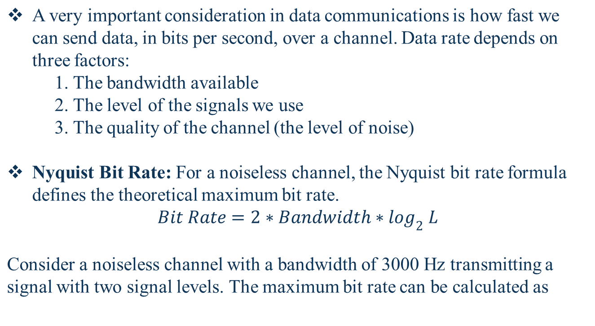

Data Rate Limits
[1] Data Communications and Networking: Behrouz Forouzan, 4th Edition.

Slide 50
Data Rate Limits
Consider the same noiseless channel transmitting a signal with four signal levels (for each level, we send 2 bits). The maximum bit rate can be calculated as
Increasing the levels of a signal may reduce the reliability of the system.
[1] Data Communications and Networking: Behrouz Forouzan, 4th Edition.

Slide 51

Data Rate Limits
We need to send 265 kbps over a noiseless channel with a bandwidth of 20 kHz. How many signal levels do we need?
Solution
We can use the Nyquist formula as shown:
Since this result is not a power of 2, we need to either increase the number of levels or reduce the bit rate. If we have 128 levels, the bit rate is 280 kbps. If we have 64 levels, the bit rate is 240 kbps.
[1] Data Communications and Networking: Behrouz Forouzan, 4th Edition.

Slide 52
Data Rate Limits
Noisy Channel: Shannon Capacity
Claude Shannon introduced a formula, called the Shannon capacity, to determine the theoretical highest data rate for a noisy channel:
      Capacity =bandwidth * log2 (1 +SNR)
Consider an extremely noisy channel in which the value of the signal-to-noise ratio is almost zero. In other words, the noise is so strong that the signal is faint. For this channel the capacity C is calculated as
This means that the capacity of this channel is zero regardless of the bandwidth. In other words, we cannot receive any data through this channel.
[1] Data Communications and Networking: Behrouz Forouzan, 4th Edition.

Slide 53
Data Rate Limits
Both Limits:
Claude Shannon introduced a formula, called the Shannon capacity, to determine the theoretical highest data rate for a noisy channel:
      Capacity =bandwidth * log2 (1 +SNR)
Consider an extremely noisy channel in which the value of the signal-to-noise ratio is almost zero. In other words, the noise is so strong that the signal is faint. For this channel the capacity C is calculated as
This means that the capacity of this channel is zero regardless of the bandwidth. In other words, we cannot receive any data through this channel.
The Shannon capacity gives us the upper limit; the Nyquist formula tells us how many signal levels we need.
[1] Data Communications and Networking: Behrouz Forouzan, 4th Edition.

Slide 54

Performance
Bandwidth:
The first, bandwidth in hertz, refers to the range of frequencies in a composite signal or the range of frequencies that a channel can pass.
The second, bandwidth in bits per second, refers to the speed of bit transmission in a channel or link.
Throughput:
It is a measure of how fast we can send the data.
Bandwidth is potential measure of a link, throughput is actual measure of the link.
A network with bandwidth of 10 Mbps can pass only an average of 12,000 frames per minute with each frame carrying an average of 10,000 bits. What is the throughput of this network?
[1] Data Communications and Networking: Behrouz Forouzan, 4th Edition.

Slide 55

Performance
Latency (Delay)
The latency or delay defines how long it takes for an entire message to completely arrive at the destination from the time the first bit is sent out from the source.
It consists of propagation time, transmission time, queuing time and processing time.
Propagation Time measures the time required for a bit to travel from the source to the destination.
Propagation time = distance / propagation speed
What is the propagation time if the distance between the two points is 12,000 km? Assume the propagation speed to be 2.4 × 108 m/s in cable.
[1] Data Communications and Networking: Behrouz Forouzan, 4th Edition.

Slide 56

Performance
Transmission time is a total time required for transmission of a message to arrive at receiver from first to last bit.
It depends on the size of the message and the bandwidth of the channel.
Transmission time = message size / bandwidth.
Queing Time: Time taken by intermediate device to process bits.
Bandwidth-delay product defines the number of bits that can fill the link.
[1] Data Communications and Networking: Behrouz Forouzan, 4th Edition.

Slide 57


Performance
[1] Data Communications and Networking: Behrouz Forouzan, 4th Edition.

Slide 58
Performance
Jitter is the difference in the packet arrival time.
It causes problem in reception for time sensitive information like audio and video or real time data.
[1] Data Communications and Networking: Behrouz Forouzan, 4th Edition.

Slide 59


Repository
http://highered.mheducation.com/sites/0072967757/information_center_view0/index.html
http://authors.phptr.com/tanenbaumcn4/
http://nptel.ac.in/courses/106105081

